Slide 1
Growth Mindset Presentation

Slide 2
GROWTH recipe
People with a growth mindset believe that their most basic abilities can be developed through dedication and hard work.
They understand that effort is the key to success.
This view creates a love of learning and a resilience that is essential for great achievement.
https://www.youtube.com/watch?v=ElVUqv0v1EE

Slide 3
“Failing is just another word for growing.”
#youcanlearnanything #khanacademy #growth
https://www.youtube.com/watch?v=JC82Il2cjqA

Slide 4
Goals of this Presentation
Understand the difference between a growth and fixed mindset
2. Comprehend how these mindsets impact a
classroom environment
3. Learn specific strategies to implement in the
classroom

Slide 5
dweck@stanford.edu
Dweck has done research over the last 30 years with children and young adults in the USA
She is particularly interested in how students view themselves as learners
The student’s self-theory is likely to have a major effect on their self-belief, their motivation to learn, and their resilience
Notes:
5

Slide 6
Why the Growth Mindset?
-Understand that intelligence can be developed
-Students focus on improvement instead of worrying about how smart they are
(work hard to learn more and get smarter)
-Students who learn this mindset show greater...
motivation in school !
better grades !!
higher test scores !!!

Slide 7
Creating a Culture
Growth Mindset is all about creating a culture that maximize student learning.
Describe the culture you want to set in your classroom. List your expectations and classroom philosophy

Slide 8
Fixed or Growth Mindset?
Fixed or Growth Quiz
Intelligence=______ effort + ________ natural ability

Slide 9
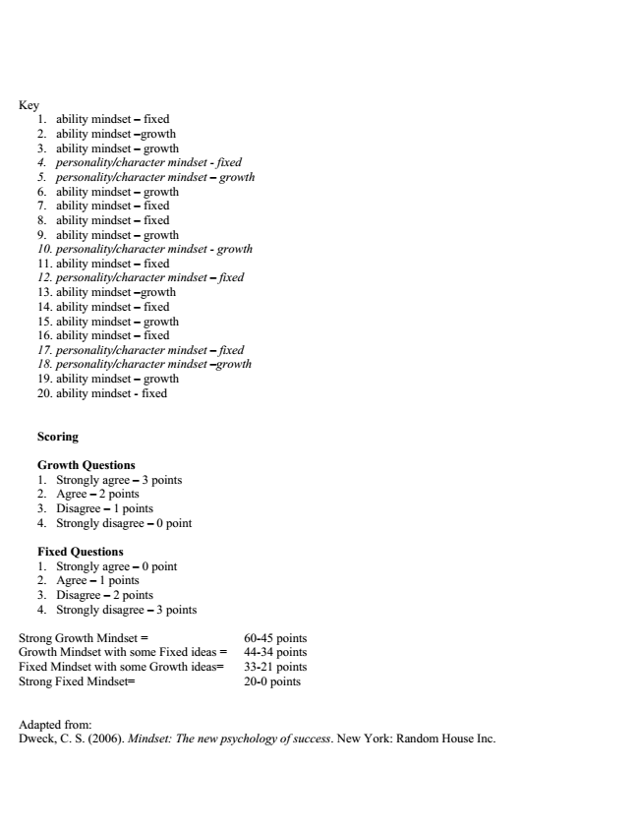

Slide 10
Student Issues
Think-Pair-Share
What are the most significant issues you have with the mindset of students at McHenry High School?

Slide 11
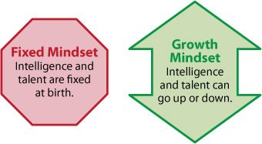
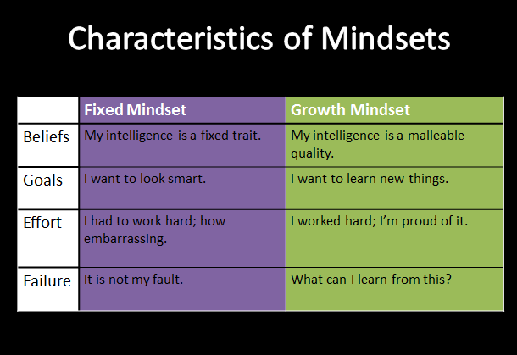
Fixed vs. Growth in a Nutshell

Slide 12
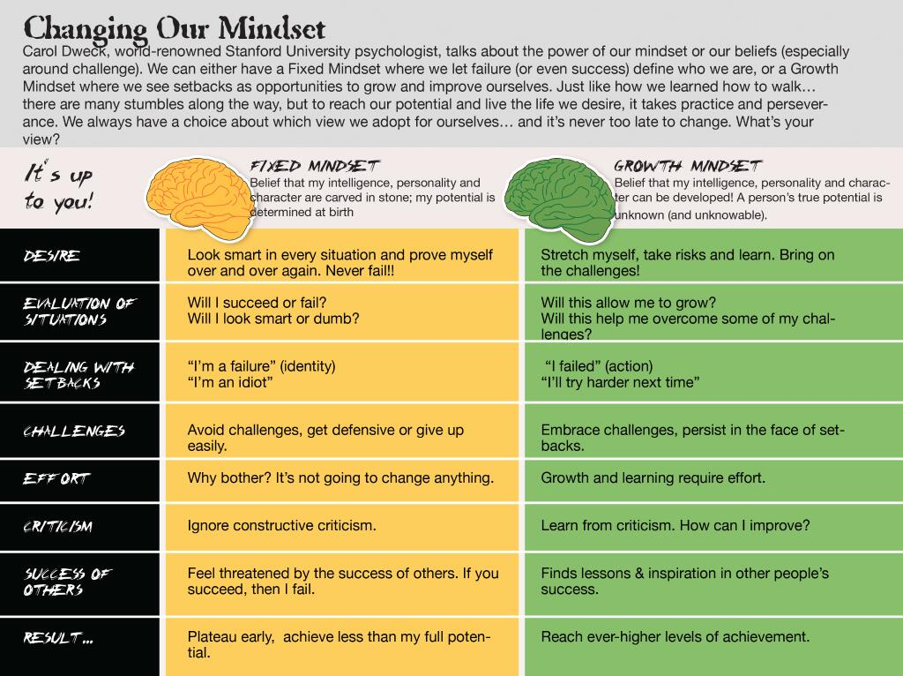

Slide 13
What does a Growth Mindset School look like?
Administrators support teachers’ learning. They are responsive to honest feedback, rather than defensive. They seek to build their skills, and are willing to learn from their teachers.
Teachers collaborate with their colleagues and instructional leaders, rather than shut their classroom doors and fly solo. They strive to strengthen their own practice, rather than blame others. They truly believe that all students can learn and succeed—and show it.
Parents support their children’s learning both inside and outside the classroom. They partner with teachers, and respond to outreach. They worry less about advocating for their children to get good grades and focus on making sure kids are being challenged and put in the effort needed to grow.
Students are enthusiastic, hard-working, persistent learners. They take charge over their own success.

Slide 14
Growth Mindset Video
Dr. Angela Duckworth: Grit
https://www.youtube.com/watch?v=H14bBuluwB8
REALIZE HARD WORK IS A KEY TO GROWTH
“The harder I have to work at something, the more effort I put into something, the better I’ll be at it”
Seems simple right?
… then why is this a pressing issue daily with our students?

Slide 15
GRIT video discussion
In Duckworth’s studies, talent and grit are often inversely correlated, meaning, the more talent, the less grit and vice versa.
The same inverse relation has been observed anecdotally. Why?
Grit also includes perseverance and hard work.
How do we instill grit in our students in this age of instant gratification?

Slide 16
Philosophy of a Growth Mindset Classroom
Sterner
Vision + Growth Mindset + Grit = Peace of Mind
Niemic
Choose Your Attitude
No Excuses
Don’t Blame Others

Slide 17
How to Implement in the Classroom?
Explain the Mindsets
provide the survey
Explain the fixed/growth chart
2. Reinforce Growth
Quote of the Week
Daily Journal (Social Scientist)
Use growth mindset quote sheet
Show short growth mindset video clips
Put up growth mindset charts in the classroom

Slide 18
How to Implement in the Classroom?
3. Daily Teaching Practices
Align with your classroom expectations
Use praise coherently with the growth mindset model
Align assessment feedback to growth mindset language
4. Student Reflections
Effort Rubric
Mindset Journal

Slide 19
The use of PRAISE
Carol Dweck: A Study on Praise and Mindsets
https://www.youtube.com/watch?v=NWv1VdDeoRY
Switch from praise for intelligence or achievement to praise for effort
Praise the process, rather than the product
Give positive feedback (maybe negative feedback if the effort is poor)

Slide 20
IN CONCLUSION (and you all moving forward) ...
Teachers are GROWTH learners – need to be good role models
Essential that we show them we believe their intelligence is not fixed
We need to make them believe they can improve
We need to ensure they know how to improve
Collaborative classroom environment where pupils take responsibility for their own learning
Pupils understand the Growth Mindset and how it can help them
Notes:
20

Slide 21
Helpful Growth Mindset Websites
Ten Tips to Develop a Growth Mindset in your Classroom
http://deeplearning.edublogs.org/2014/08/03/top-ten-tips-for-developing-a-growth-mindset-in-your-classroom/#.VK12GmTF8me
2. Growth Mindset Videos
http://www.mindsetworks.com/webnav/videogallery.aspx#FosteringGrowthMindsets
https://www.youtube.com/results?search_query=growth+mindset
3. Creating a Growth Mindset in Your Students
http://www.thoughtfullearning.com/blogpost/get-smart-become-talent

